Slide 1






Quality Audit Performance Dashboard
-By Krushnakant Patil

Slide 2
INTRODUCTION
The primary objective of this report is to evaluate the operational quality and process compliance across the organization for the 2019 fiscal year. By analyzing audit data from the Backoffice, Sales, and Finance departments, this report identifies critical performance gaps, highlights excellence in management, and provides data-driven strategies to minimize defects and errors.

Slide 3
Objective:-
To analyze employee performance, defects %, errors %, and overall quality score using interactive dashboards.
Analyze overall quality performance
Track Defects % and Errors % by month
Compare performance across:
Departments
Managers
Employees
Locations
Identify low-performing areas
Support data-driven decision making

Slide 4
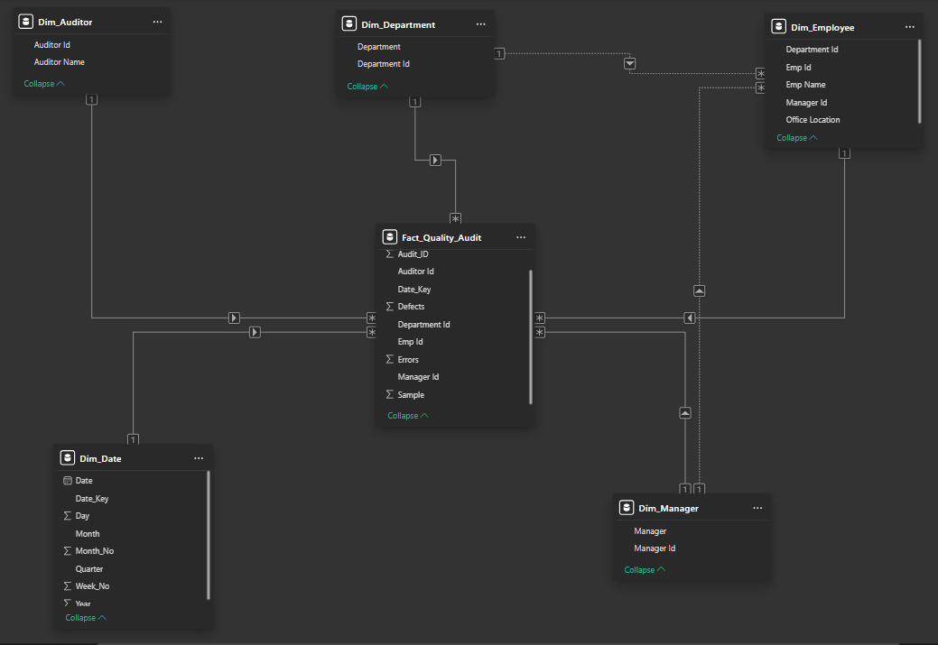
Data Model
Star Schema
Main Table is Fact Quality Audit
One-Dim_Auditor to Many-Fact_Quality_Audit-(Relationship is 1 to *)
One-Dim_Department to Many-Fact_Quality_Audit-(Relationship is 1 to *)
One-Dim _Employee to Many-Fact_Quality_Audit-(Relationship is 1 to *)
One-Dim_Date to Many-Fact_Quality_Audit-(Relationship is 1 to *)
One-Dim_Manager to Many-Fact_Quality_Audit-(Relationship is 1 to *)
One -Dim_Depeartment to Many-Dim_Employee-(Relationship is 1 to *)
Many-Dim_Employee is One-Dim_Manager-(Relationship is * to 1)

Slide 5
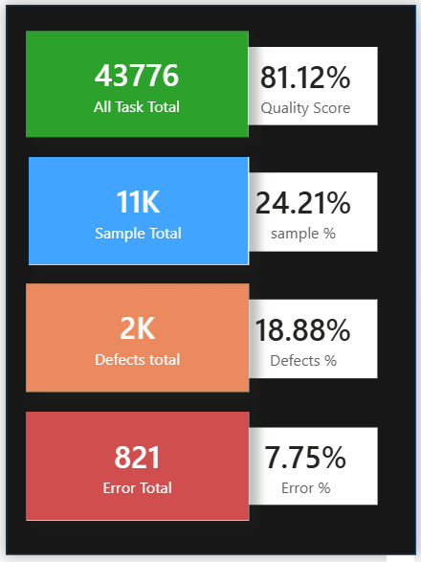
Overall Quality Performance
The Quality Audit Dashboard provides a comprehensive overview of task quality, defect rates, and error trends across departments, managers, employees, and locations.
  Overall Quality Score: 81.12 %
  Total Tasks: 43776
  Overall Sample Score: 24.21 %
  Sample Total: 1100
  Overall Defects Score: 18.88 %
  Total Defects: 2000
  Overall Errors Score:7.75
  Total Error:- 821
  Defects % is higher than Errors %
Insights:
  Quality score is stable around 79–82%
  Defects % higher than Errors %

Slide 6
Department Performance Analysis
Top Performing Department:
  Sales (Stable and consistent quality score: 83.94%)
  Lower defects and controlled error rates
Low Performing Department:
  Finance (Slightly lower quality score: 79.55%)
  Higher defect percentage compared to others
Sales Department:
  Handles the highest workload
  Moderate performance with improvement potential

Slide 7
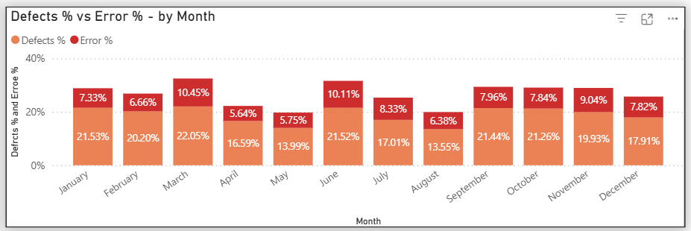
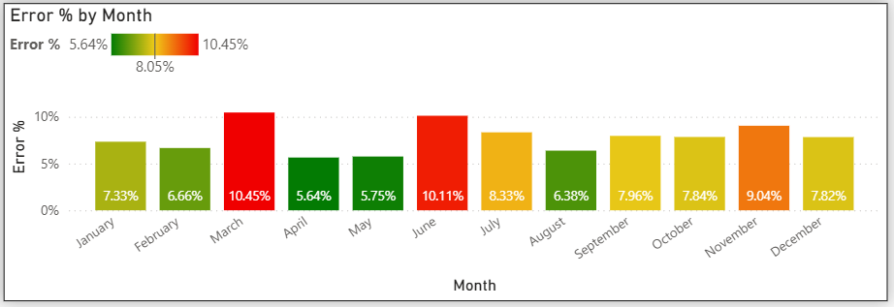
Monthly Analysis Trends & Patterns in Defects and Errors
Monthly Trends:
March shows peak defects (22.05%) and errors (10.45%)
April shows lowest error percentage (5.64%)
Performance fluctuates month-to-month
Need investigation in peak months
Observations:
Defects % consistently higher than Errors %
Certain managers and employees show recurring quality gaps
Regional variation impacts quality performance

Slide 8
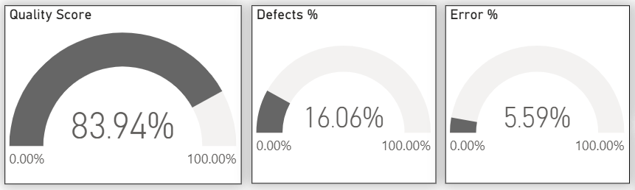
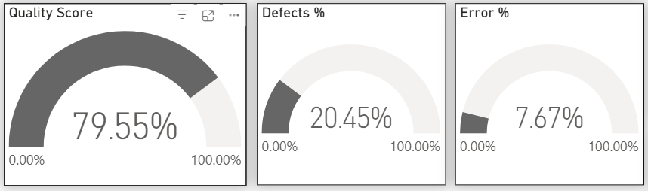

Department Analysis
Sales - Sales department shows moderate performance
Finance - Finance slightly lower quality score
Backoffice - Backoffice stable
Sales Department Comparisons to Quality Score Vs Defects % Vs Error %
Finance Department Comparisons to Quality Score Vs Defects % Vs Error %
Backoffice Department Comparisons to Quality Score Vs Defects % Vs Error %

Slide 9
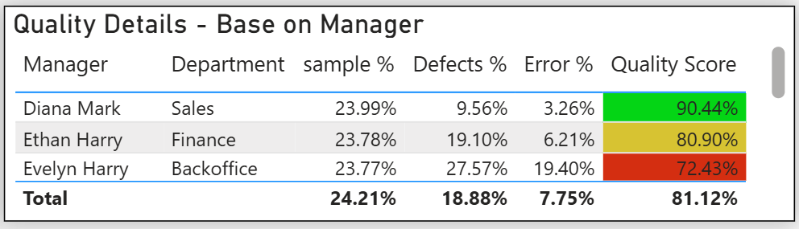
Quality Details base on Manager Performance Analysis
Insights:
Diana Mark – High Quality Score & Sample%
Evelyn Harry – Higher defects %
Ethan Harry – Low Error %
Identify managers needing improvement

Slide 10
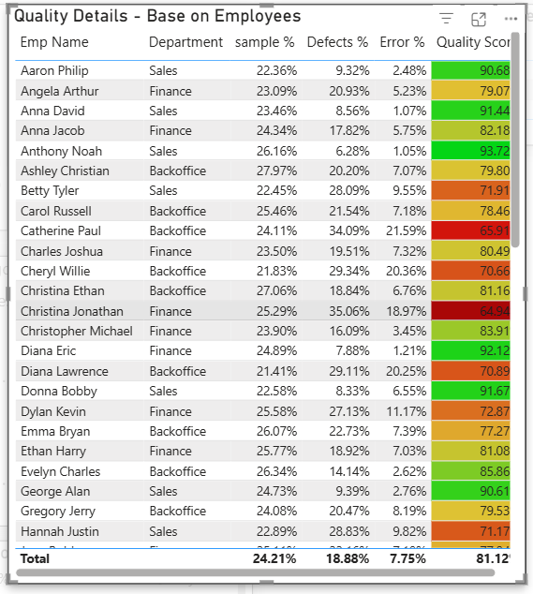
Quality Details base on Employee Performance Analysis
Anthony Noah is the department of sales employee best quality score.
Christian Jonathan is the department of finance employee low quality score.
Catherine Paul is the department of backoffice employee high Error % .
Ryan Bryan is the department of sales employee low Error %.
Christina Jonathan is the department of finance employee high Defects %.
Anthony Noah is the department of sales employee low Defects %.
Jennifer Arthur is the department of backoffice employee high sample %.
Julie Aaron is the department of seles employee low sample %.

Slide 11
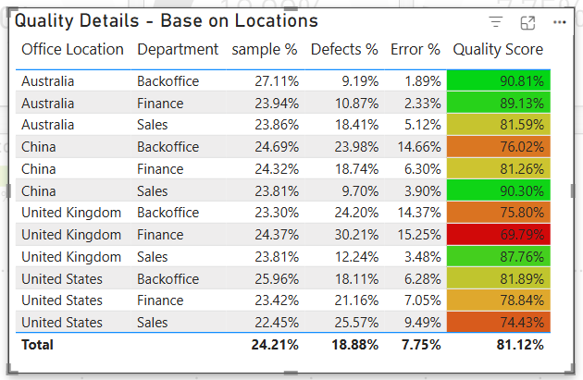
Quality Details base on Location Analysis
In the Australian Department of Backoffice, quality score are performing high.
United Kingdom finance quality score is low
United Kingdom finance department Error % and Defects % is High.
Australia backoffice department Error % and Defects % is low
Australia backoffice department Sample % is High
United States sales department sample % is low

Slide 12
Key Performance Gaps Identified
Quality Score 81.12% overall
Certain managers associated with higher defect rates
Regional inconsistency in quality standards
These patterns indicate operational or training-related challenges.
Defects % more critical than Errors %
Some managers/locations need improvement
Sales department dominates workload

Slide 13
Actionable Recommendations
Short-Term Actions:
  Conduct targeted training for low-performing employees
  Investigate root causes for high defect months
  Introduce weekly quality monitoring reviews
  Provide feedback dashboards to managers
Medium-Term Actions:
  Standardize quality processes across departments
  Implement performance-based incentives
  Automate repetitive error-prone processes
Long-Term Strategy:
  Develop a predictive quality monitoring system
  Implement continuous improvement framework
  Use trend analysis for proactive risk management

Slide 14


Business Recommendations
Provide training for low-performing employees
Conduct root cause analysis for high defect months
Monitor managers with higher error rates
Implement continuous quality monitoring
Use dashboard for monthly review meetings

Slide 15

Strategic Improvement Suggestions.
To enhance overall quality performance:
Adopt data-driven review meetings using the dashboard.
Strengthen accountability at manager level.
Align workload distribution to reduce process pressure.
Introduce quality KPIs linked to performance appraisals.
Promote a culture of continuous quality improvement.

Slide 16
Conclusion
The Quality Audit Dashboard enables:
  360° performance visibility
  Helps identify risk areas
  Supports data-driven decisions making
  Strategic performance optimization
  Enables management to take corrective actions
While overall performance remains stable (83%), focused intervention in high-defect areas can significantly improve organizational efficiency and customer satisfaction.

Slide 17
THANK
YOU

